Slide 1
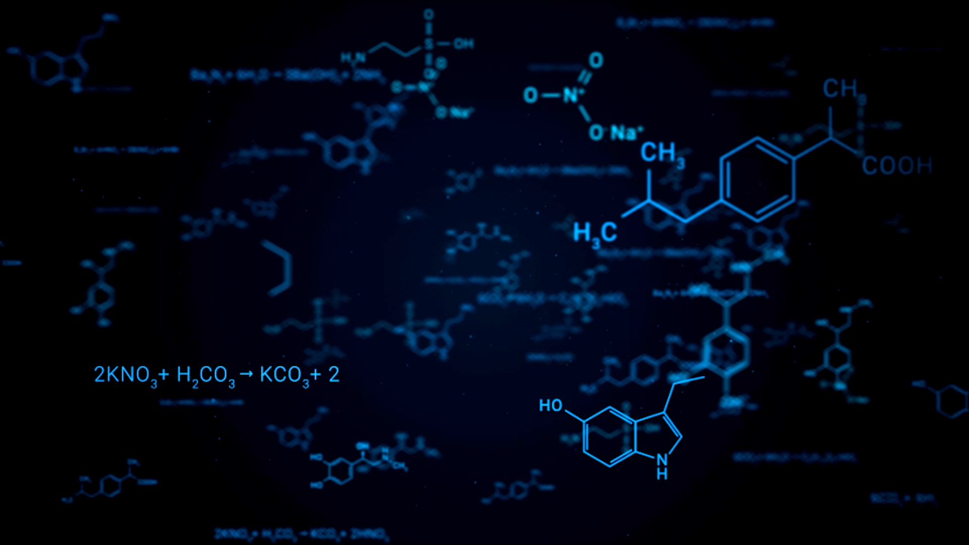
SPACE BIOLOGY 101 A Smart Search Engine for Scientific Publications and Knowledge Graphs Presented by: Maahin Rathinagiriswaran & Rohan Sada

Slide 2
How can we make a vast library of NASA bioscience publications easily understandable?
Information Overload
Keyword Search is limited
Goal: Create an intuitive tool that allows users to "ask questions" of the entire knowledge base and receive direct, synthesized answers with verifiable sources.

Slide 3
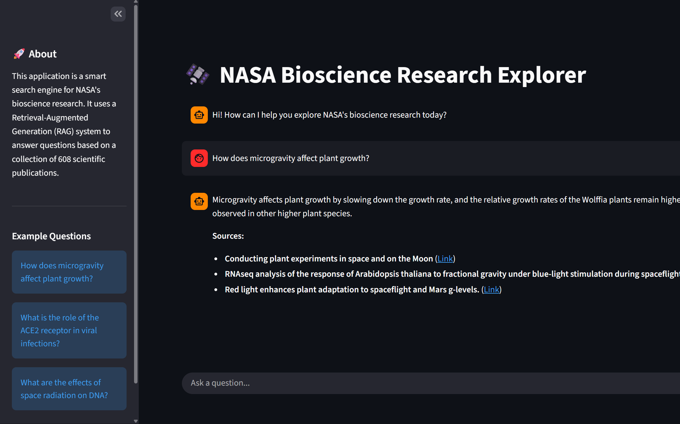
Our Solution: A RAG-Powered Application
A web application that uses Retrieval-Augmented Generation (RAG) to provide a conversational interface for exploring the research.
What is RAG? A technique that combines the power of a Large Language Model (LLM) with a specific knowledge base.
It consists of the following 3 core ideas:
Retrieve
Augment
Generate

Slide 4
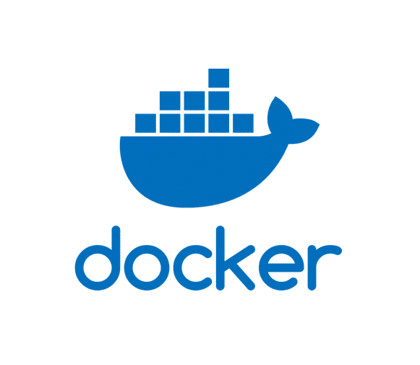
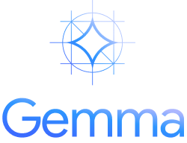
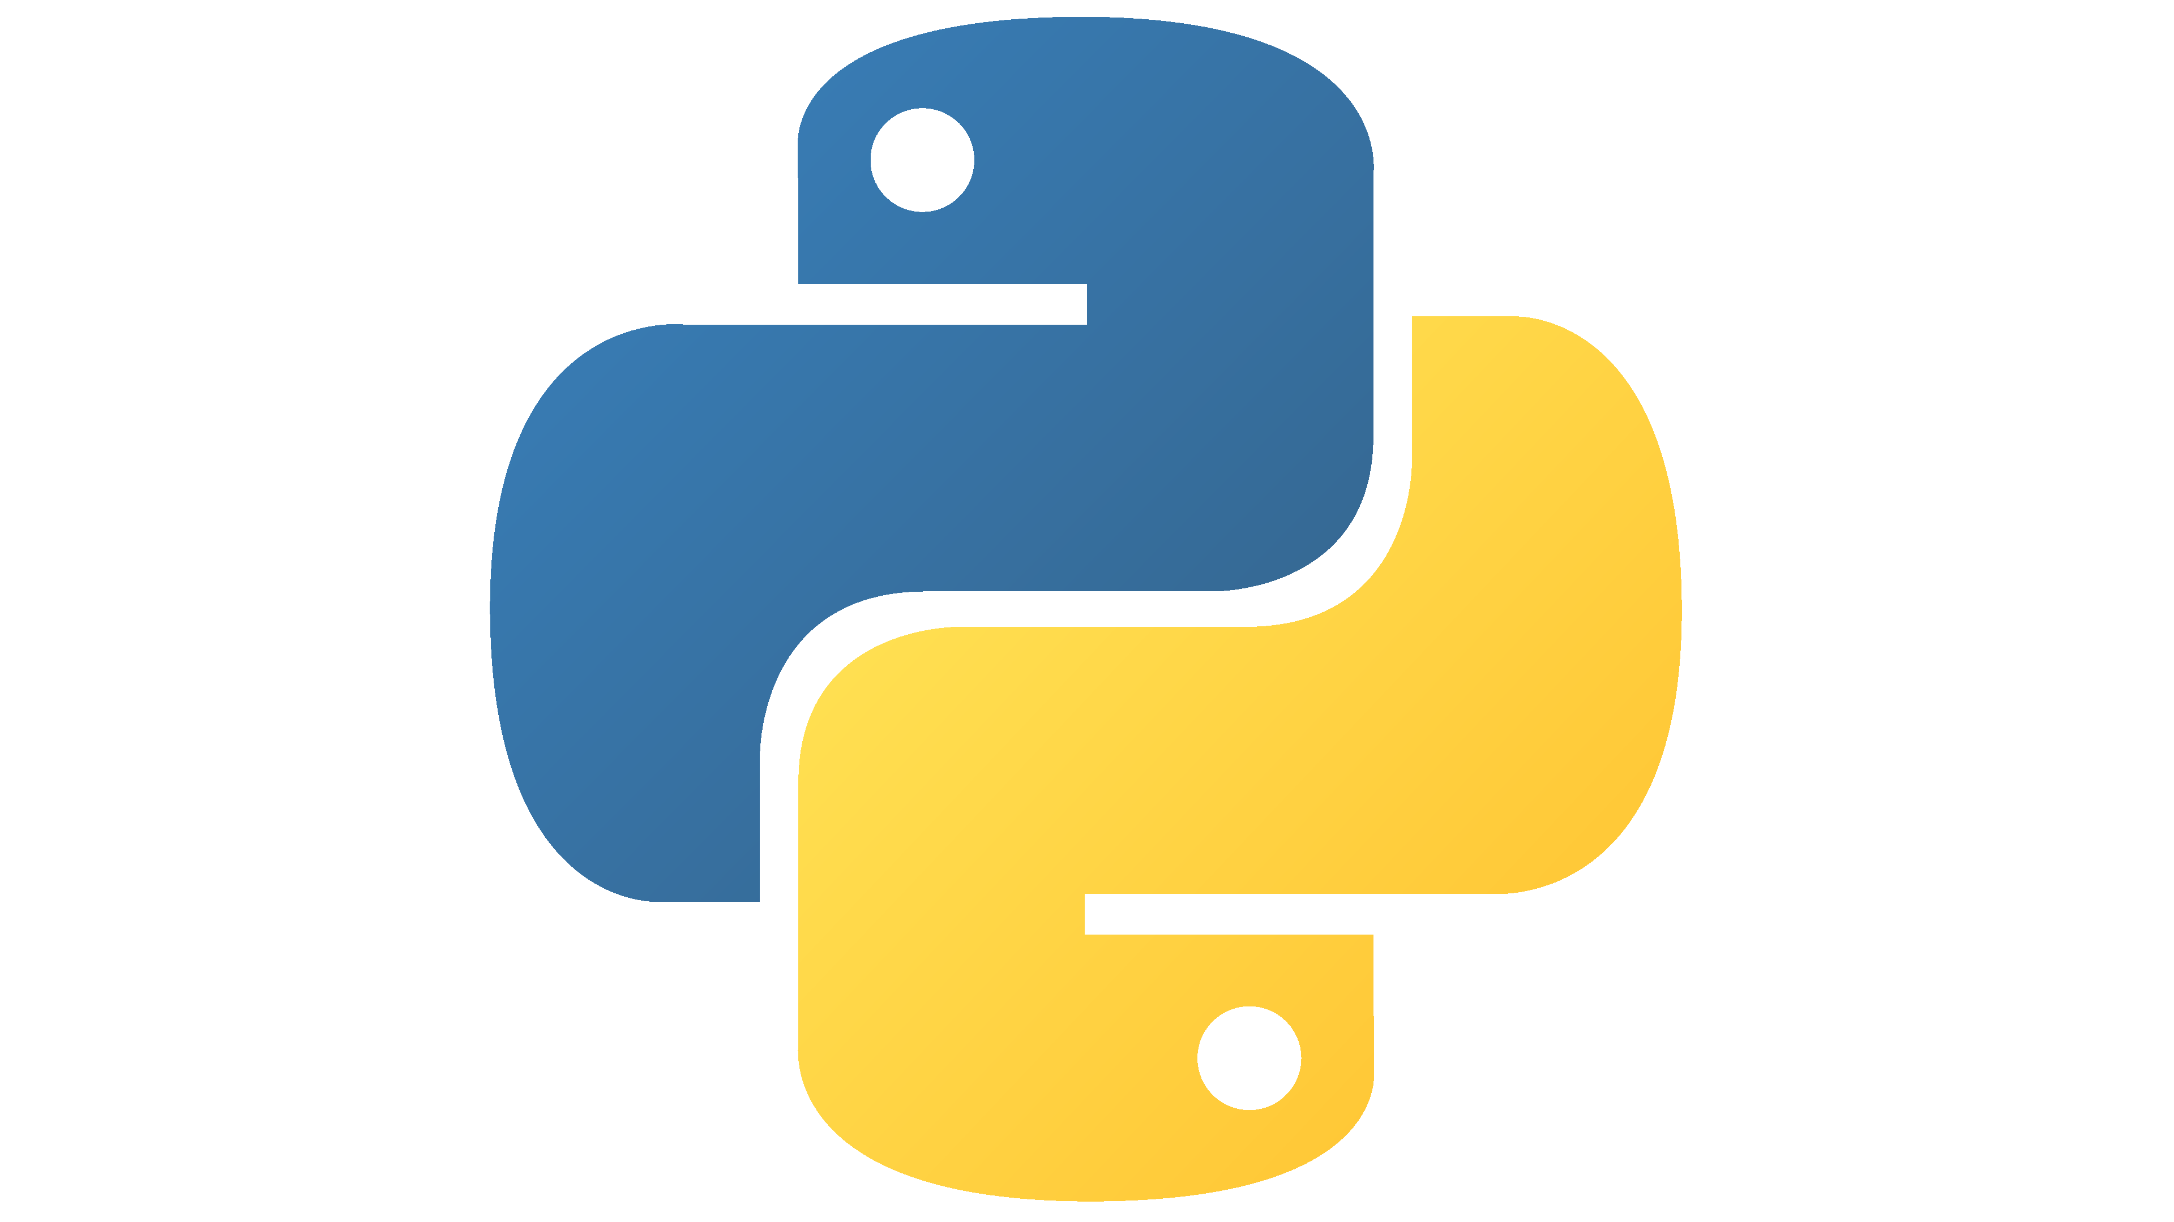



System Architecture
Our application follows a two-stage process: an initial Indexing Pipeline and a live Inference Pipeline.
Data Loading
Chunking
Embedding & Indexing
User Query
Retrieval
Generation
Response

Slide 5
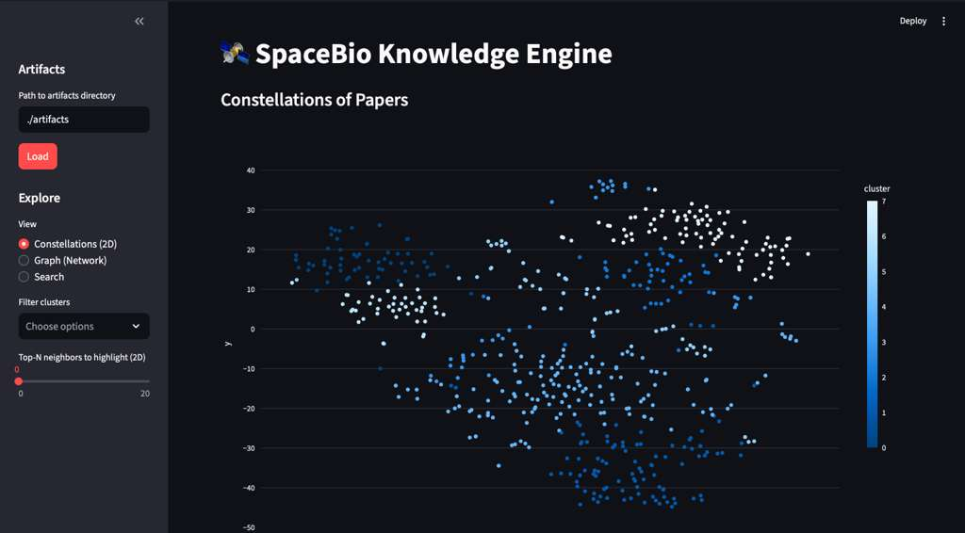
Constellations View
Each paper → mean embedding → 2D map (UMAP)
GRAPHICAL INTERPRETATION
Position: close = similar
Color: cluster
Constellations: visible groups of related papers.

Slide 6
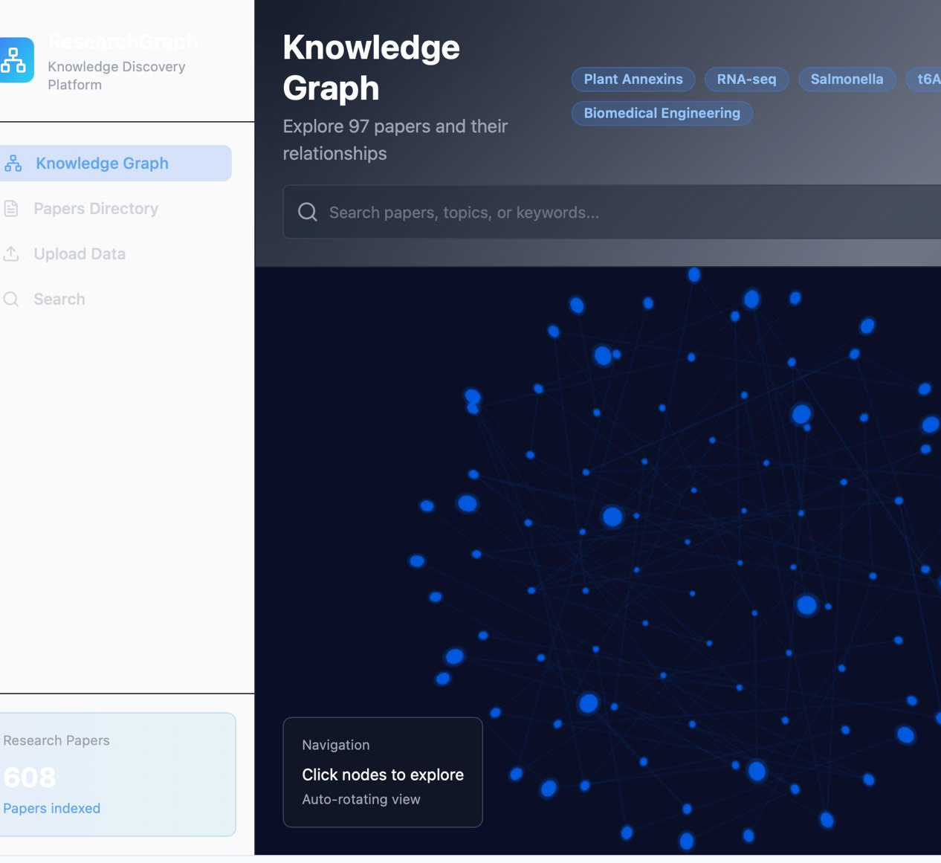
Base44 Assisted Knowledge Graph

Slide 7


THANK YOU! Any Questions?
CONTACT US
mr2049@scarletmail.rutgers.edu
LinkedIn: Maahin Rathinagiriswaran
rs2531@scarletmail.rutgers.edu
LinkedIn: Rohan Sada

